Slide 1
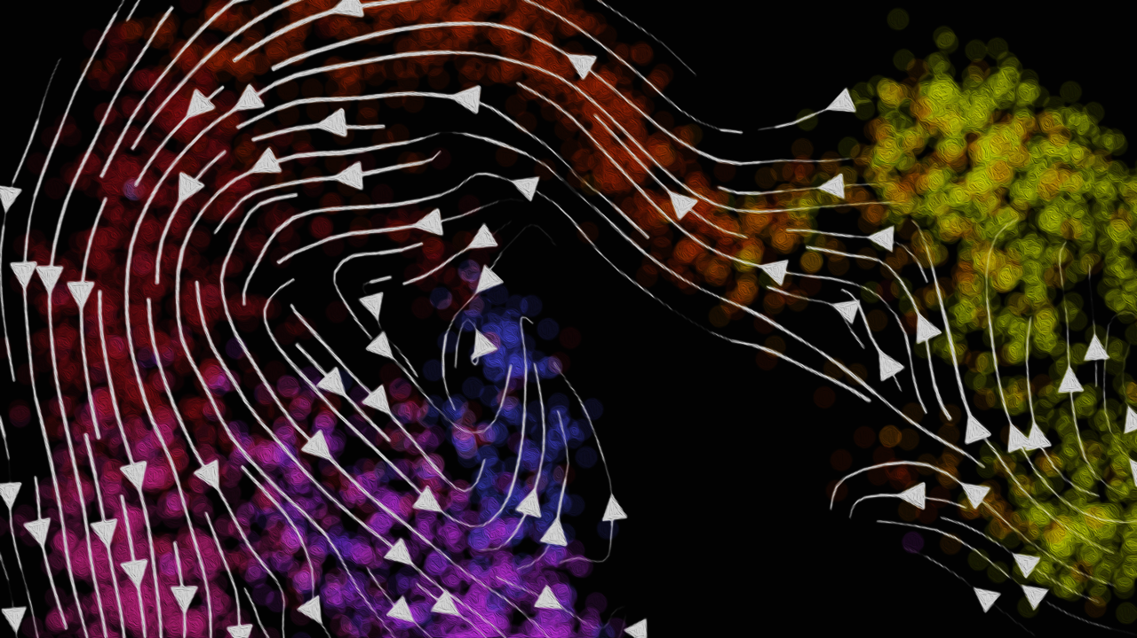
Modeling and Visualizing
RNA Velocity
Jean Fan, PhD
Assistant Professor
Center for Computational Biology
Department of Biomedical Engineering
Johns Hopkins University

Slide 2
MERFISH Review

Slide 3
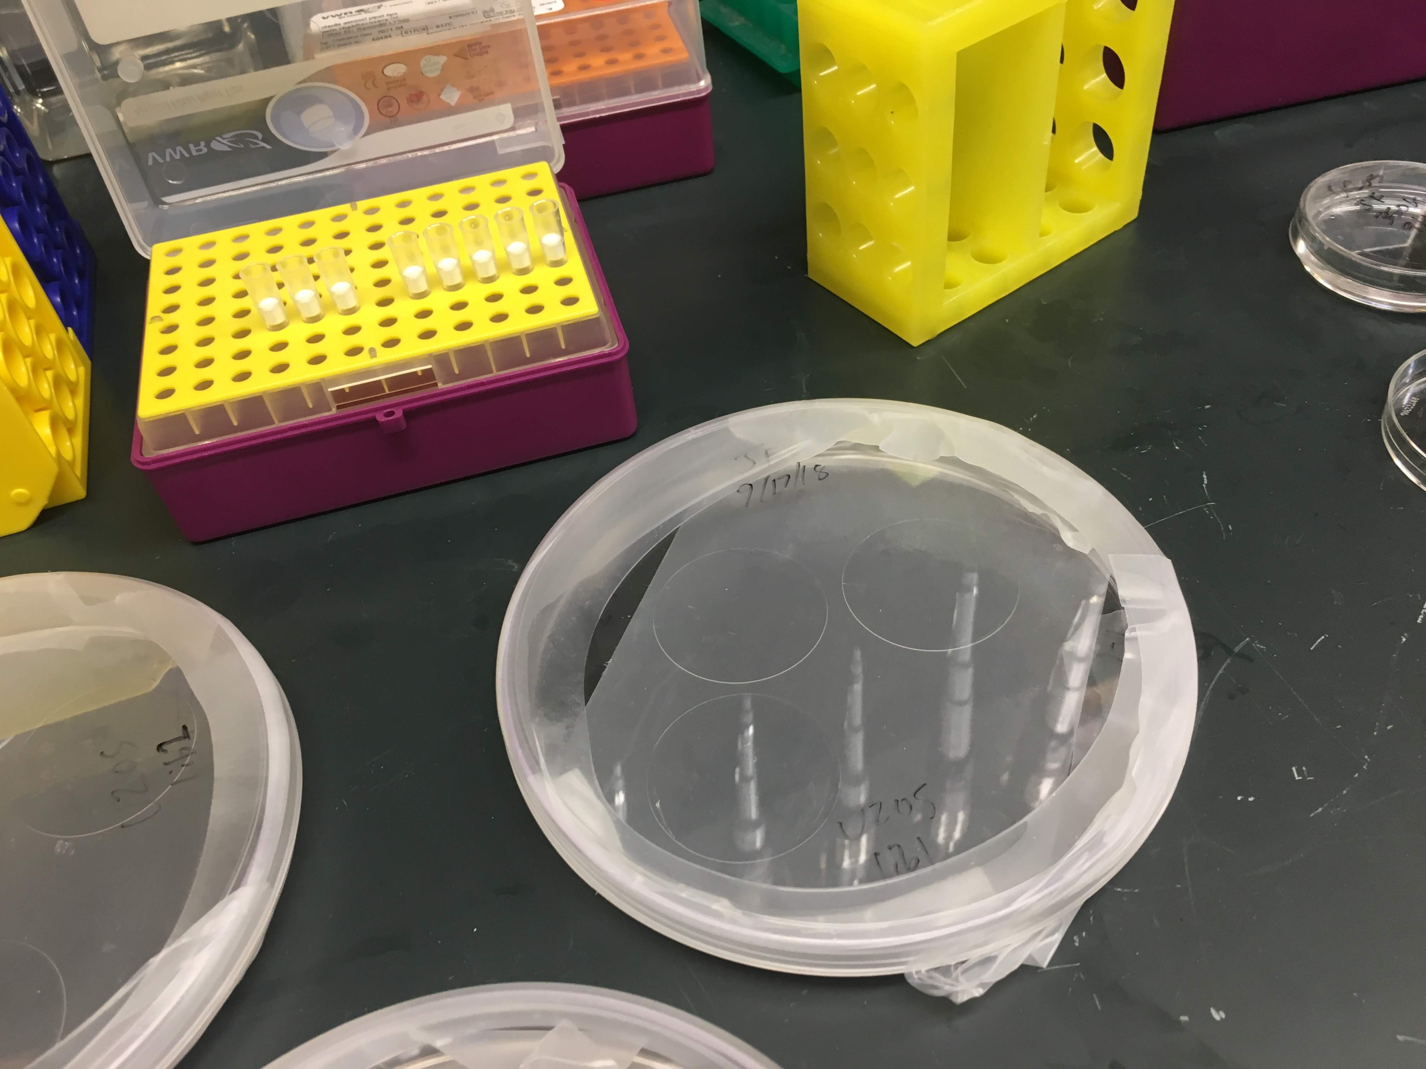
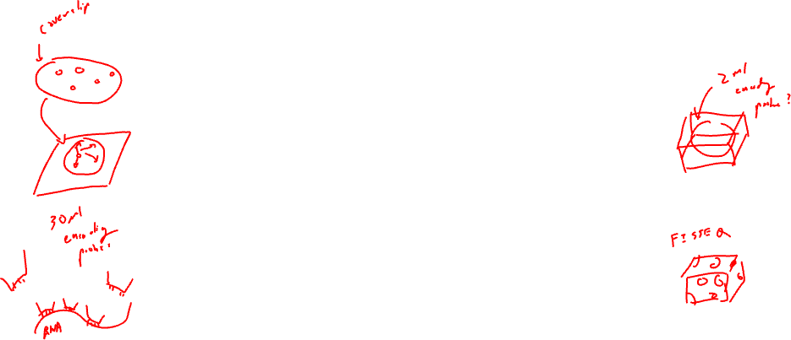
fix cells, hybridize encoding probe @46C over night, wash away unbound probes

Slide 4
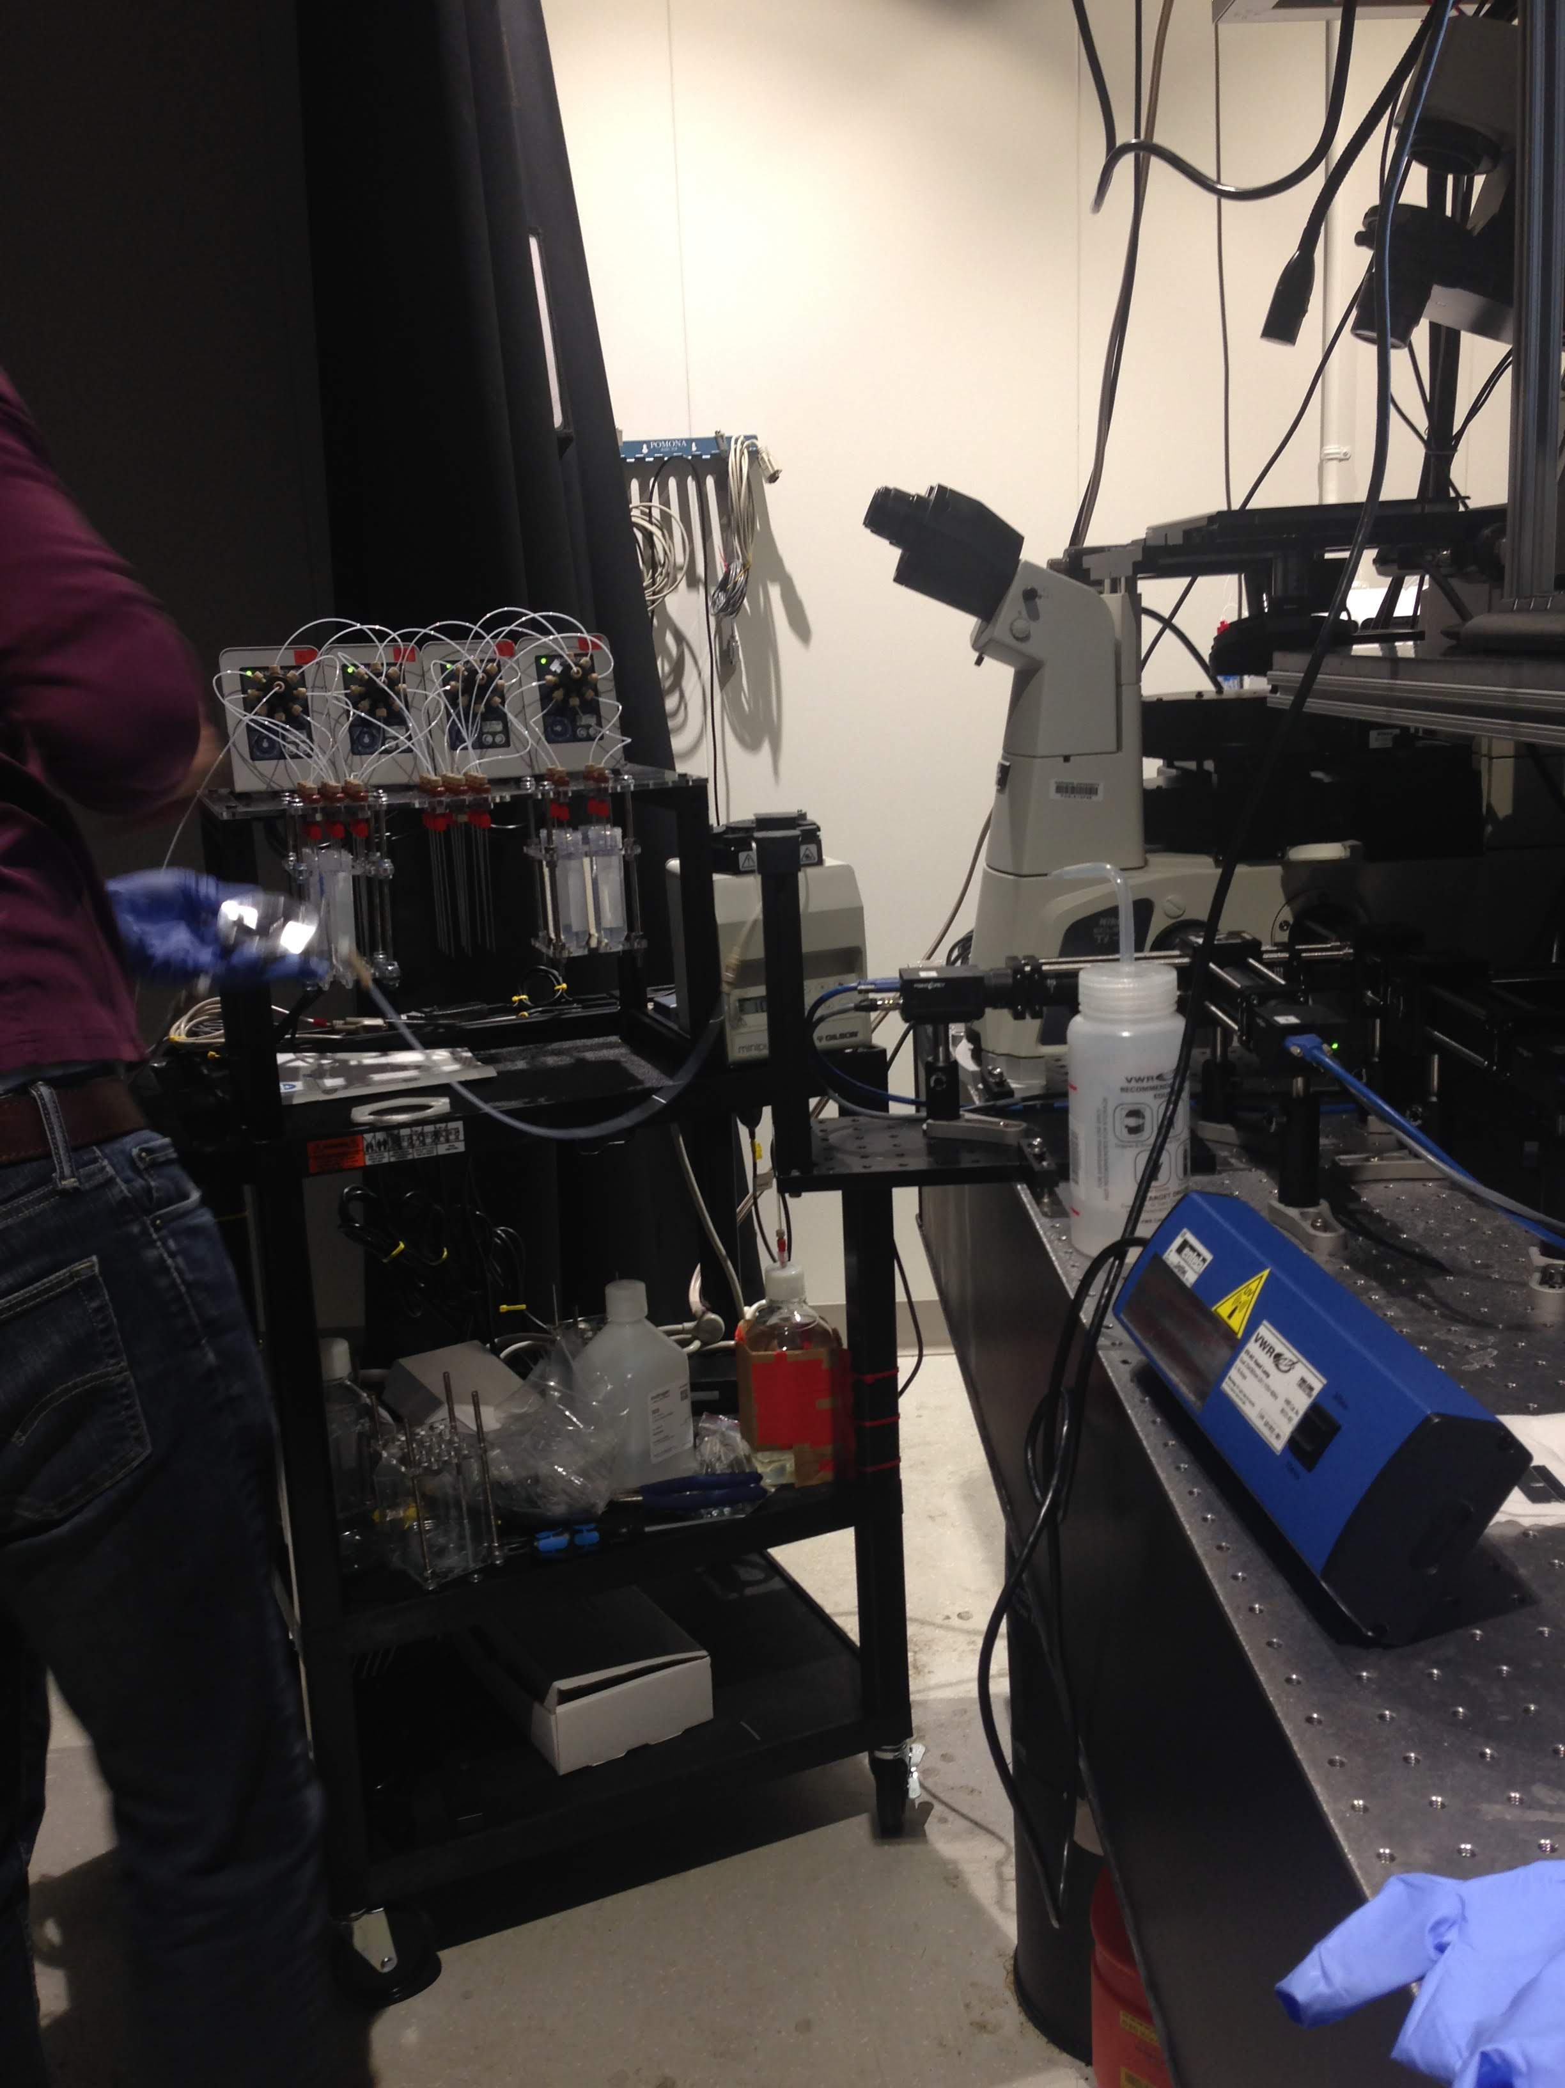
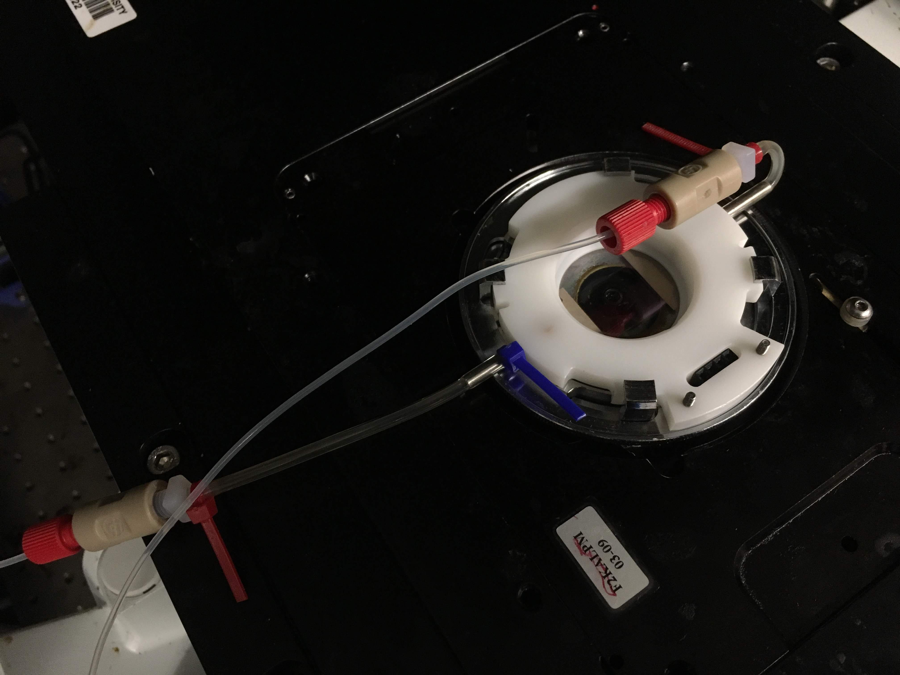
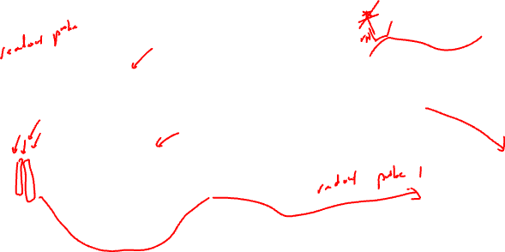
flow on readout probes using microfluidics, wait a few minutes, wash away unbound probes

Slide 5
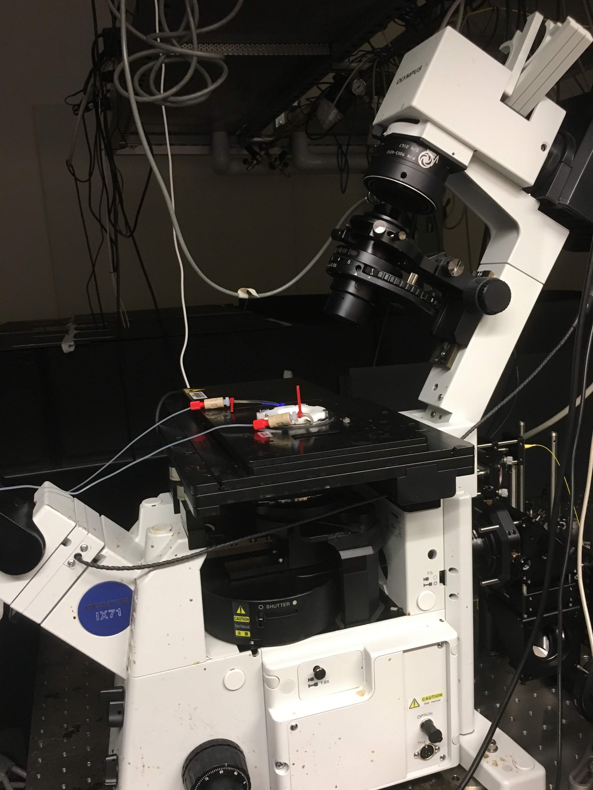
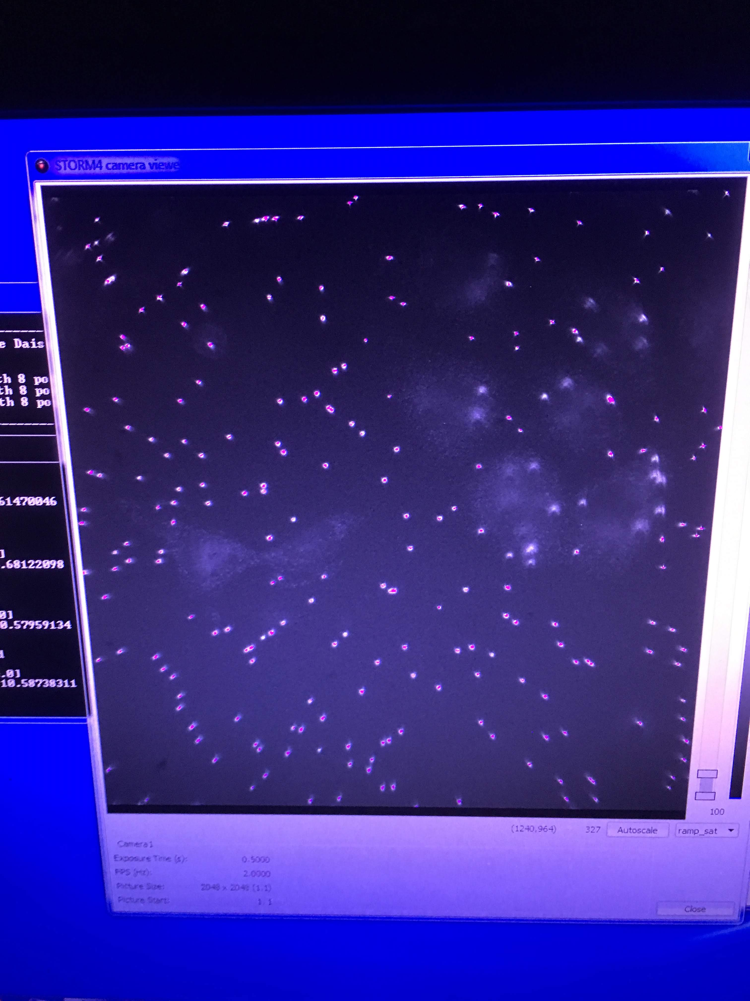
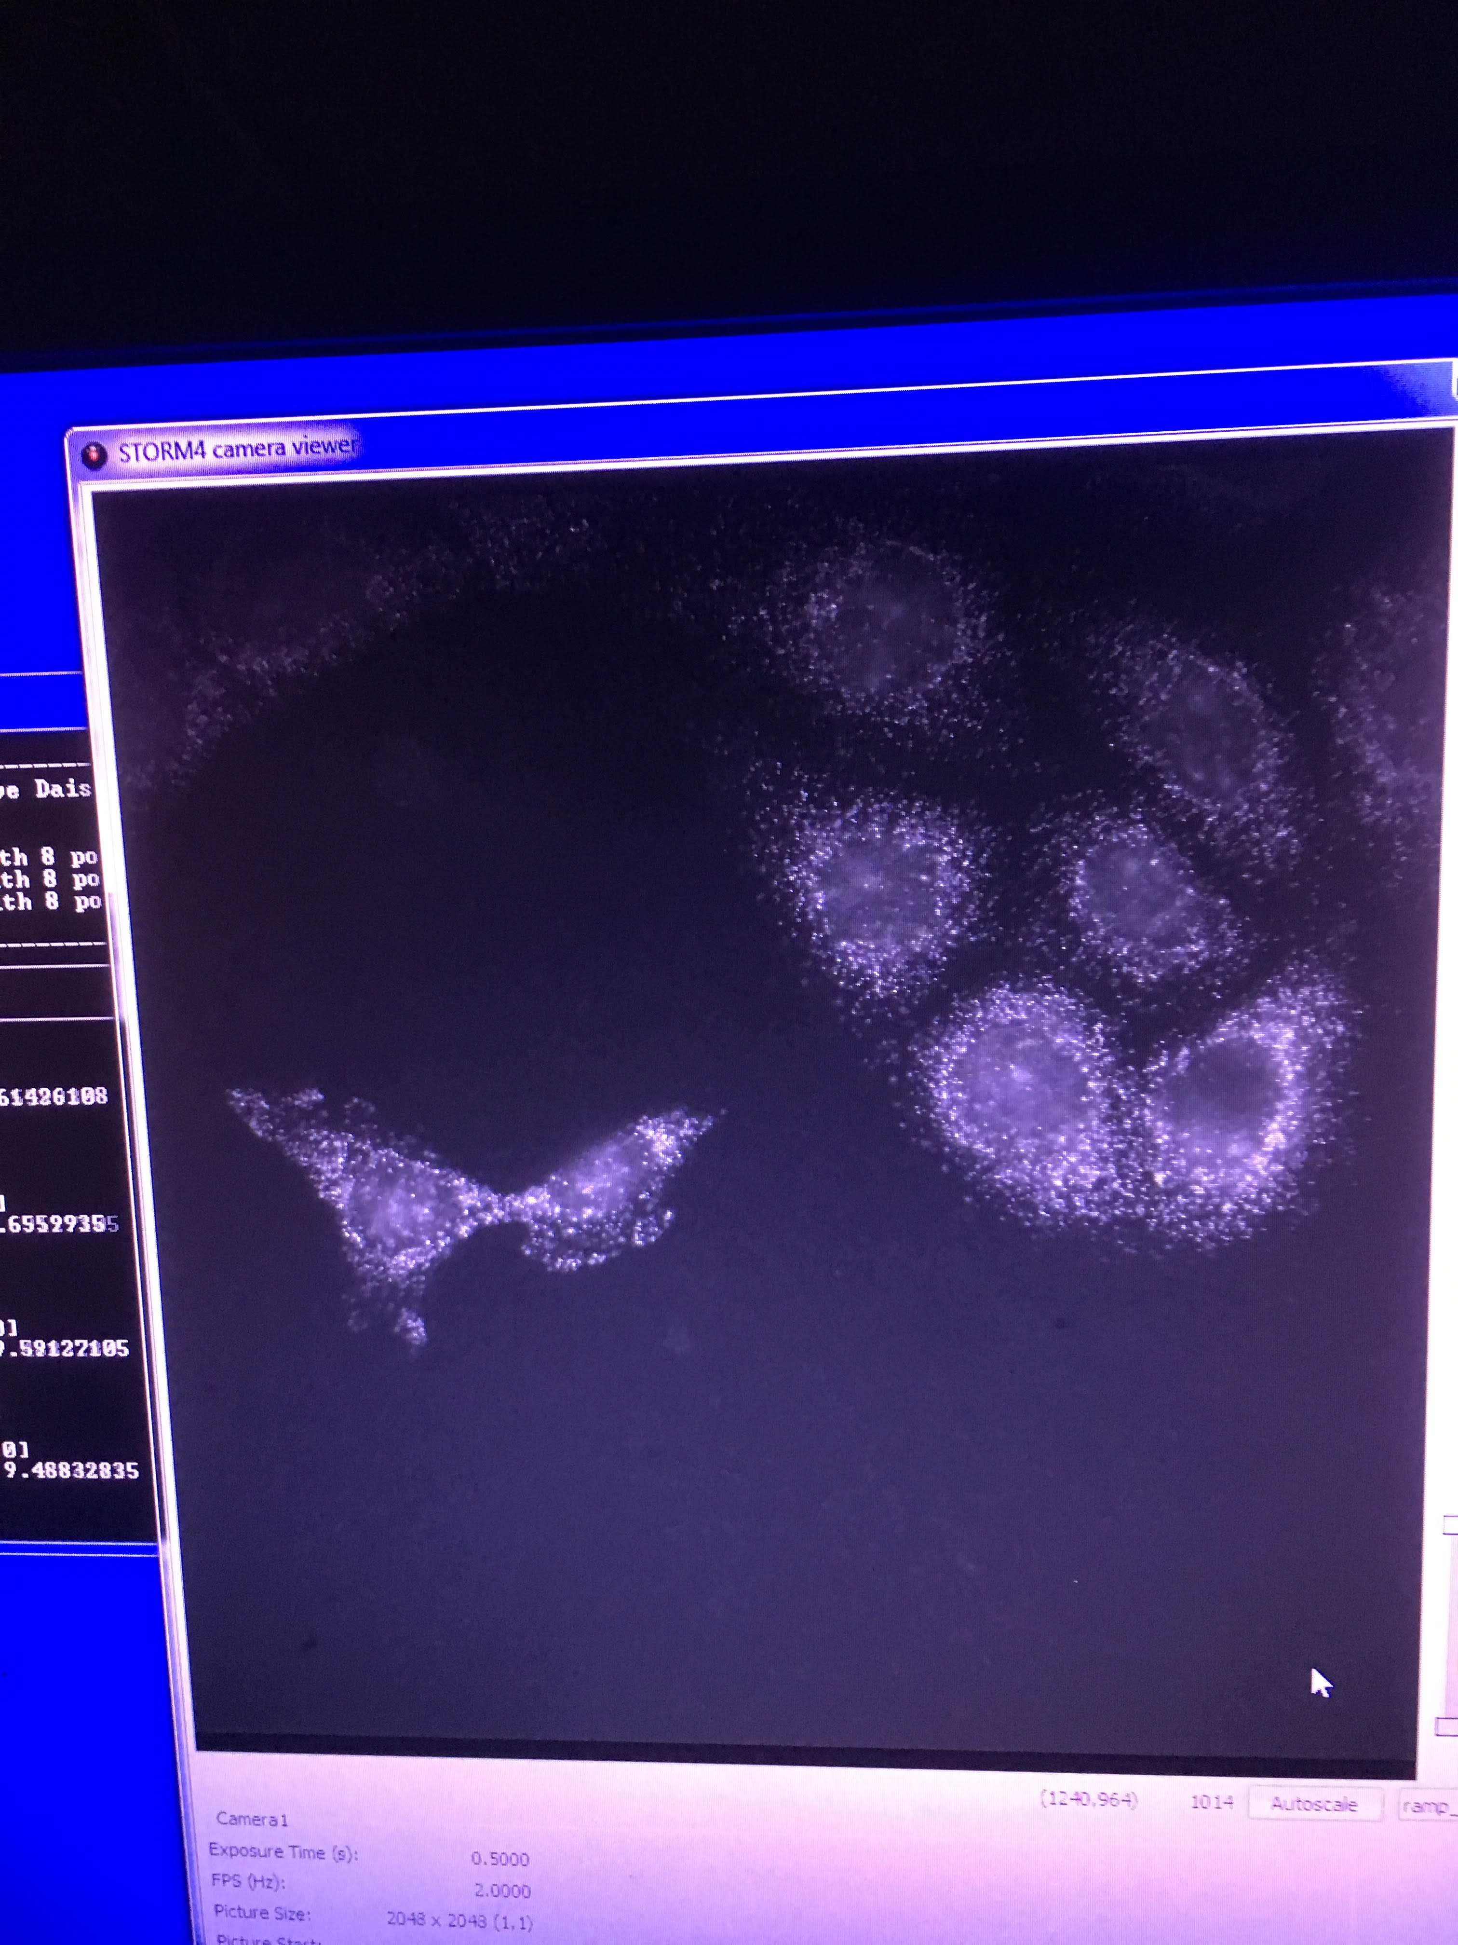

take pictures across many fields of views

Slide 6
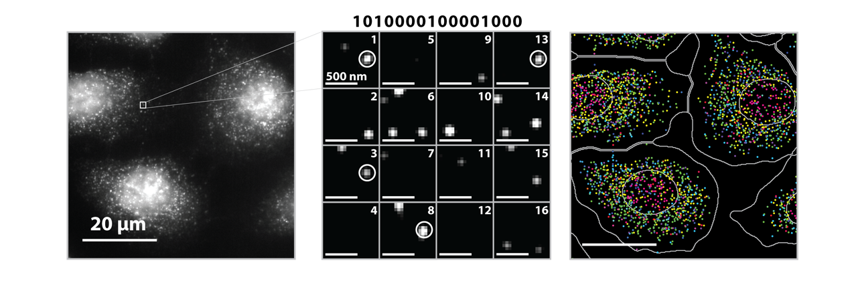
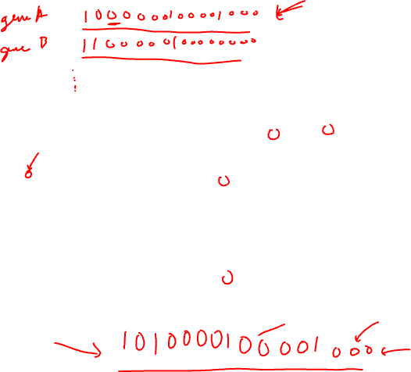
Source: Vizgen, Moffitt lab

Slide 7
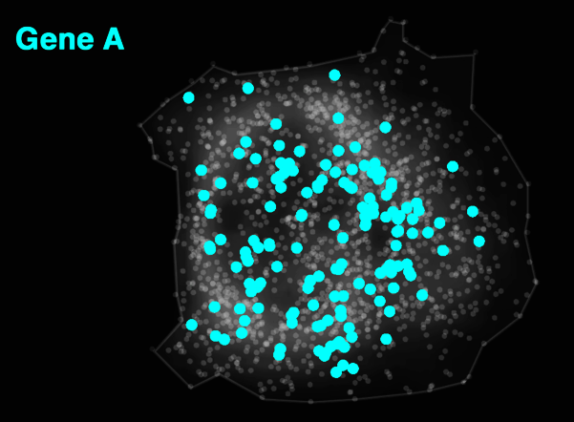
Decoded Data
Notes:
But effectively what MERFISH allows us to do is image RNA molecules that correspond to Gene A
And simultaneously also
...

Slide 8
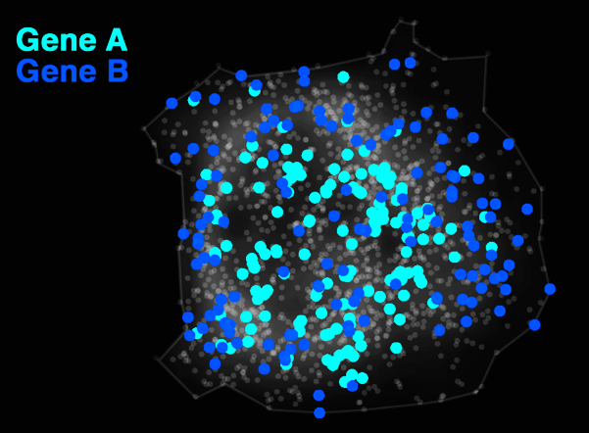
Decoded Data

Slide 9
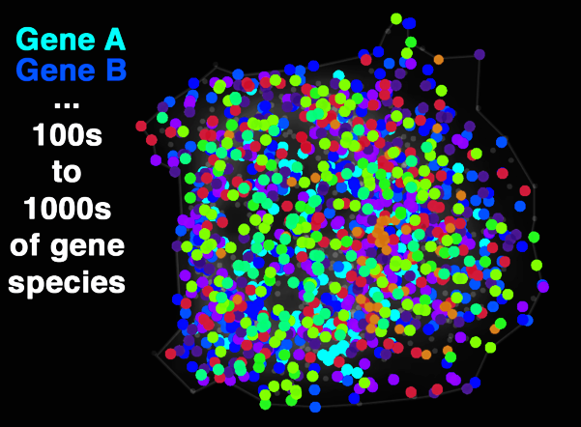
Decoded Data
Notes:
16 to 64 rounds of imaging

Slide 10
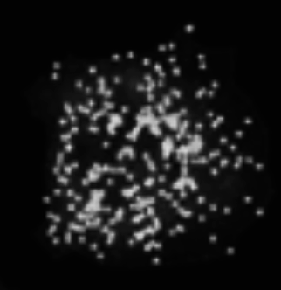
Notes:
And of course we can do this not only for one cell

Slide 11
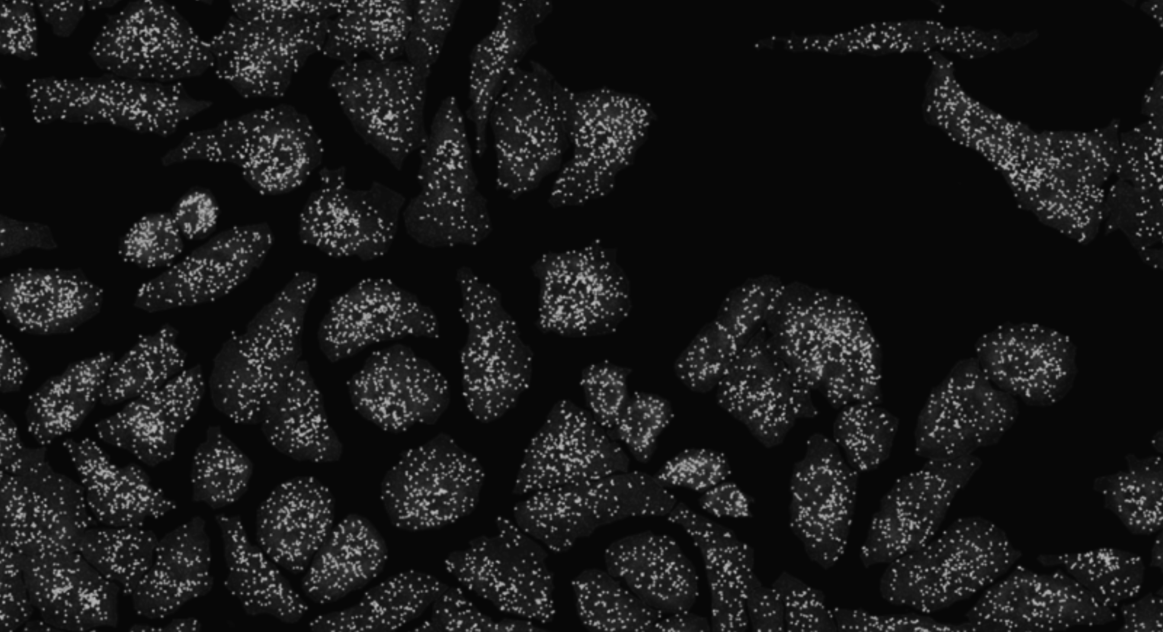

Slide 12
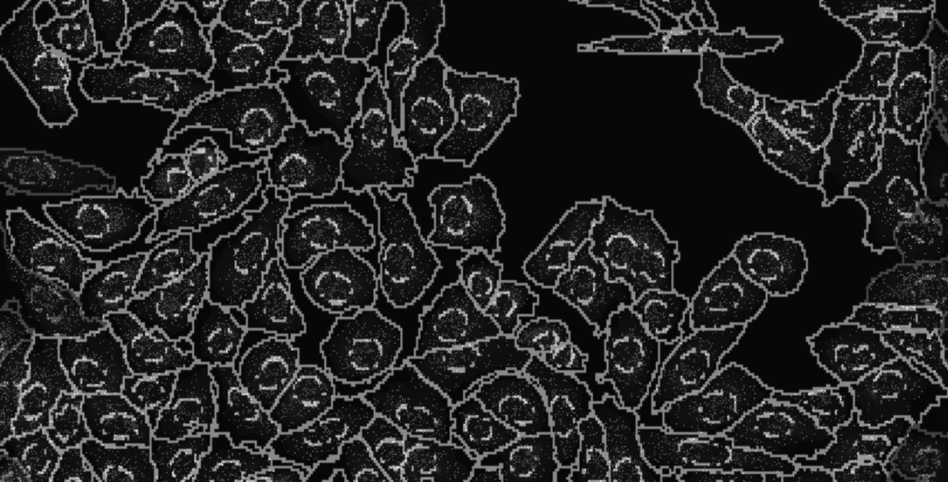


Slide 13

(Vizgen 2021)
Notes:
What these technologies allow us to do is not only image where cells are within fixed tissues (here we have a cortical section of the mouse cortex)

Slide 14
(Vizgen 2021)
Notes:
But we can see how genes are expressed within these cells within the tissues
With red being high expression and blue being low expression f
or a targeted set of genes

Slide 15

(Vizgen 2021)
Notes:
But we can see how genes are expressed within these cells within the tissues
With red being high expression and blue being low expression f
or a targeted set of genes

Slide 16
(Vizgen 2021)
Notes:
But we can see how genes are expressed within these cells within the tissues
With red being high expression and blue being low expression f
or a targeted set of genes

Slide 17
(Vizgen 2021)
Notes:
But we can see how genes are expressed within these cells within the tissues
With red being high expression and blue being low expression f
or a targeted set of genes

Slide 18
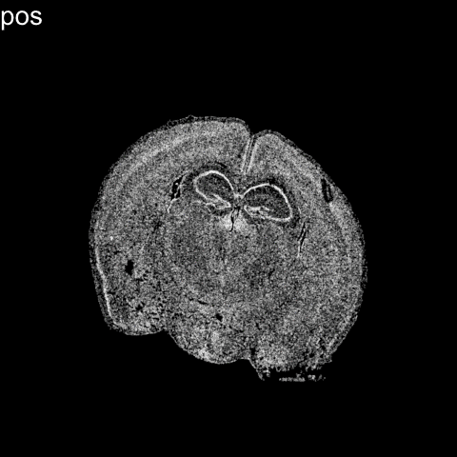


Slide 20
Limitation: cells are fixed
Expression measurements represent static snapshots in time

Slide 21









Slide 22
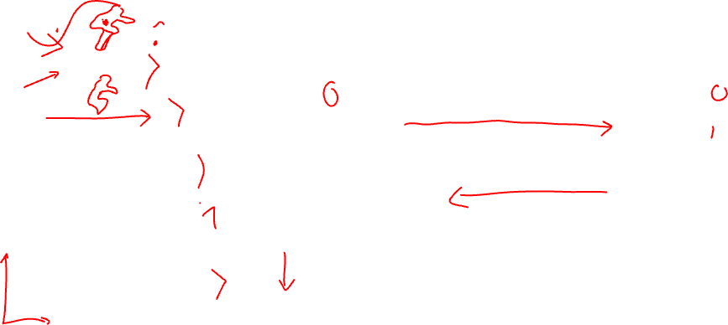
pseudotemporal ordering

Slide 23
directed pseudotemporal ordering

Slide 24







Distance away from the water

Slide 25
Distance away from the rock ledge

Slide 26
OPCs
Genes to be downregulated as a cell matures
Mature
Oligoden
drocytes

Slide 27
OPCs
Genes to be upregulated as a cell matures
Mature
Oligoden
drocytes

Slide 29
pseudotemporal ordering

Slide 30
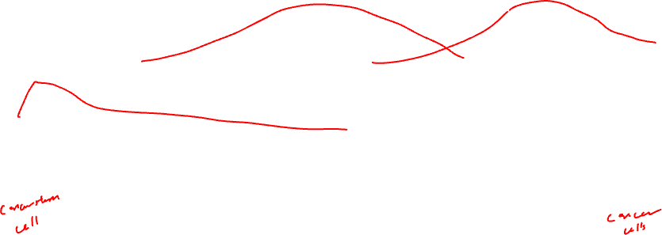
Which way does it go?

Slide 31
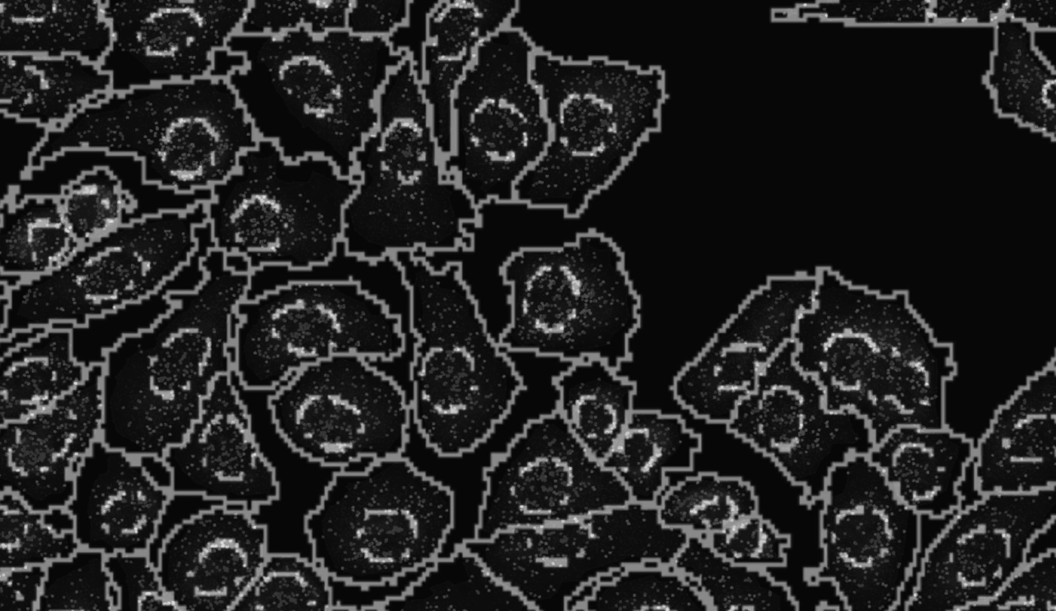


Slide 32
Nuclear vs. cytoplasmic subcellular organization of mRNAs is linked to the regulation of protein expression
(La Manno, et al Nature, August 2018)
(Xia*, Fan*, Emanuel*, et al PNAS, Sept 2019)

Slide 33
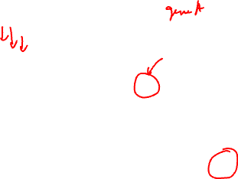
Nuclear vs. cytoplasmic subcellular organization of mRNAs is linked to the regulation of protein expression
Oligodendrocyte
maturation marker
(La Manno, et al Nature, August 2018)
(Xia*, Fan*, Emanuel*, et al PNAS, Sept 2019)

Slide 34
Nuclear vs. cytoplasmic subcellular organization of mRNAs is linked to the regulation of protein expression
(La Manno, et al Nature, August 2018)
(Xia*, Fan*, Emanuel*, et al PNAS, Sept 2019)

Slide 35

RNA velocity in situ analysis leverages nuclear and cytoplasmic gene expression to predict the future transcriptional state of cells
(La Manno, et al Nature, August 2018)
(Xia*, Fan*, Emanuel*, et al PNAS, Sept 2019)

Slide 36
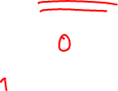
RNA velocity in situ analysis leverages nuclear and cytoplasmic gene expression to predict the future transcriptional state of cells
(La Manno, et al Nature, August 2018)
(Xia*, Fan*, Emanuel*, et al PNAS, Sept 2019)

Slide 37
RNA velocity in situ analysis leverages nuclear and cytoplasmic gene expression to predict the future transcriptional state of cells
(La Manno, et al Nature, August 2018)
(Xia*, Fan*, Emanuel*, et al PNAS, Sept 2019)

Slide 38
RNA velocity in situ analysis leverages nuclear and cytoplasmic gene expression to predict the future transcriptional state of cells
Assuming constant velocity
(La Manno, et al Nature, August 2018)
(Xia*, Fan*, Emanuel*, et al PNAS, Sept 2019)

Slide 39
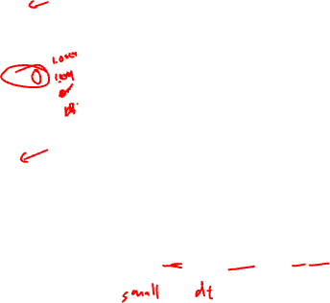
RNA velocity in situ analysis leverages nuclear and cytoplasmic gene expression to predict the future transcriptional state of cells
Assuming constant velocity
(La Manno, et al Nature, August 2018)
(Xia*, Fan*, Emanuel*, et al PNAS, Sept 2019)

Slide 40

RNA velocity in situ analysis leverages nuclear and cytoplasmic gene expression to predict the future transcriptional state of cells
Oligodendrocyte
maturation marker
Assuming constant velocity
(La Manno, et al Nature, August 2018)
(Xia*, Fan*, Emanuel*, et al PNAS, Sept 2019)
Notes:
What is the future c(t+dt) for cells are steady state?

Slide 41
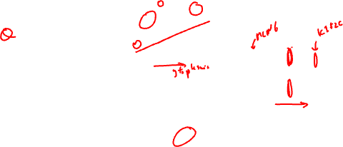
RNA velocity in situ analysis leverages nuclear and cytoplasmic gene expression to predict the future transcriptional state of cells
(Xia*, Fan*, Emanuel*, et al PNAS, Sept 2019)
Notes:
Indeed

Slide 42
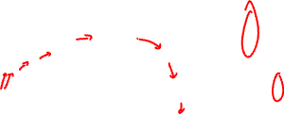
Clustering analysis identifies transcriptionally distinct cell states among cultured U2OS cells
matrix of
gene x cell
(Xia*, Fan*, Emanuel*, et al PNAS 2019)

Slide 43
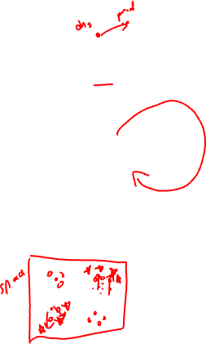
Clustering analysis identifies transcriptionally distinct cell states among cultured U2OS cells
matrix of
gene x cell
(Xia*, Fan*, Emanuel*, et al PNAS 2019)

Slide 44
RNA velocity in situ analysis provides a directed ordering of cells so we can look at gene expression as a function of pseudotime
MCM6
KIF2C
(Xia*, Fan*, Emanuel*, et al PNAS 2019)
Notes:
MCM6: encodes a protein that is a component of the Minichromosome Maintenance Complex essential for the initiation of eukaryotic genome replication in G1/S phase transition
KIF2C: encodes a kinesin-like protein that is involved mitotic chromosome segregation during M phase

Slide 45
Pseudotime analysis identifies new cell-cycle genes and highlights gradual transcriptional change throughout select cell-cycle stages
Novel
Known
(Xia*, Fan*, Emanuel*, et al PNAS 2019)

Slide 46
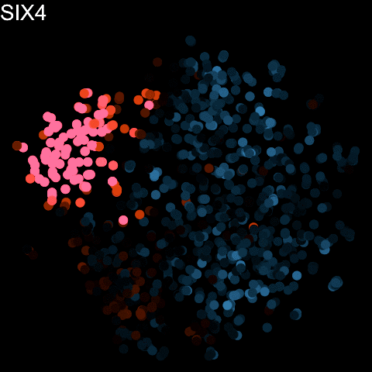

Slide 47
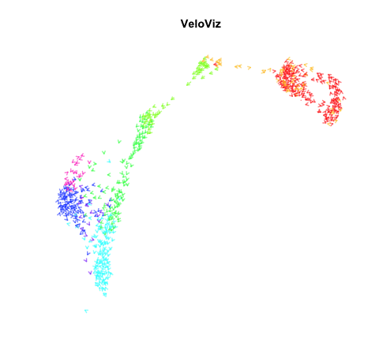
(Atta et al, Bioinformatics 2021)

Slide 48
For those interesting in background: RNA velocity in single-cell sequencing

Slide 49
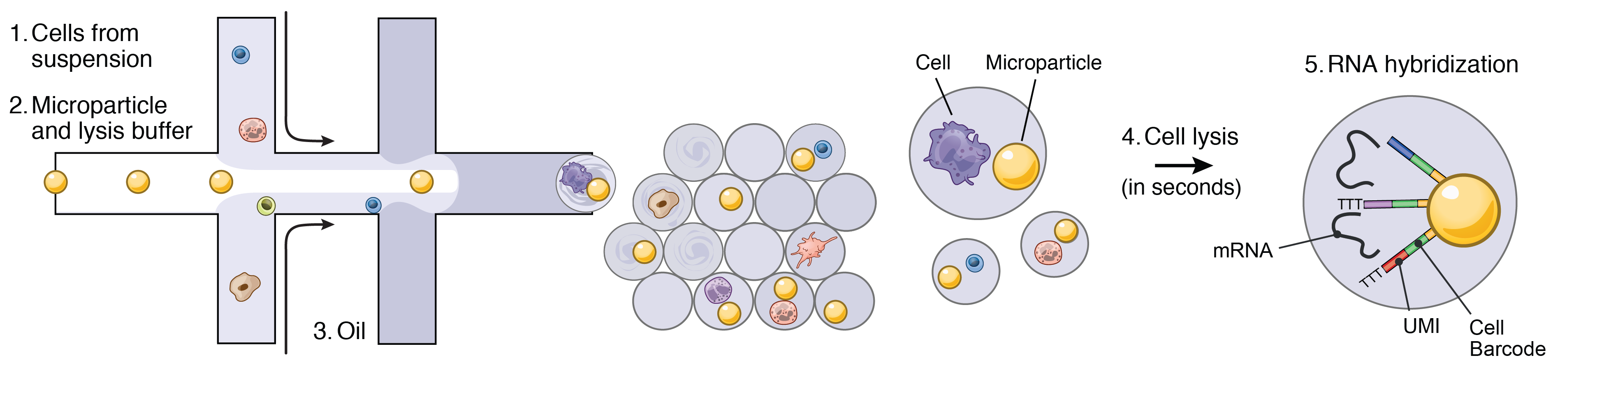
RNA Velocity analysis started with single-cell RNA sequencing…how did the authors distinguish nascent from mature RNAs?

Slide 50
RNA velocity analysis leverages spliced and unspliced gene expression to predict the future transcriptional state of cells
(La Manno, et al Nature 2018)

Slide 51
RNA velocity analysis leverages spliced and unspliced gene expression to predict the future transcriptional state of cells
(La Manno, et al Nature 2018)

Slide 52
Dimensionality reduction and clustering analysis identifies transcriptionally distinct groups of cells in single cell RNA-seq data
matrix of
gene x cell
(La Manno, et al Nature 2018)

Slide 53
RNA Velocity analysis relates these groups of cells as a part of an underlying directed cellular trajectory
matrix of
gene x cell
(La Manno, et al Nature 2018)

Slide 54
(La Manno, et al Nature 2018)
Notes:
Which cell-type is the stem-cell type that gives rise to all these other cell-types?

Slide 55
Resources
Try out the software: http://velocyto.org/
https://scvelo.readthedocs.io/en/stable/
Little challenging to install so we will skip this
Hands on component
Interactive visualizations with gganimate

